Slide 1


Portfolio Optimization
PRAHARSH DEEP SINGH

Slide 2

Presentation Outline
portfolio
Rationale
Correlation structure
weighting scheme
Summary Statistics & Beta
variations of weighted portfolios
3

Slide 3






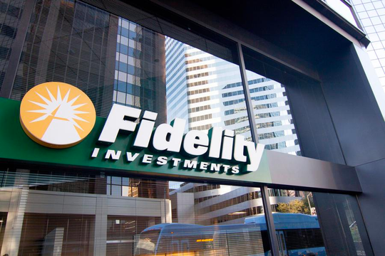
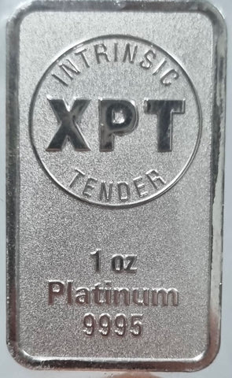

portfolio
AAPL
INTC
GE
PFE
Moving Average Go Flat
Bolinger Bands
Moving Average Go Short
Bolinger Bands
SPY
FBNDX
XPT
GBP
Moving Average Go Short
Moving Average Go Flat
Moving Average Go Short
Moving Average Go Short
4

Slide 4
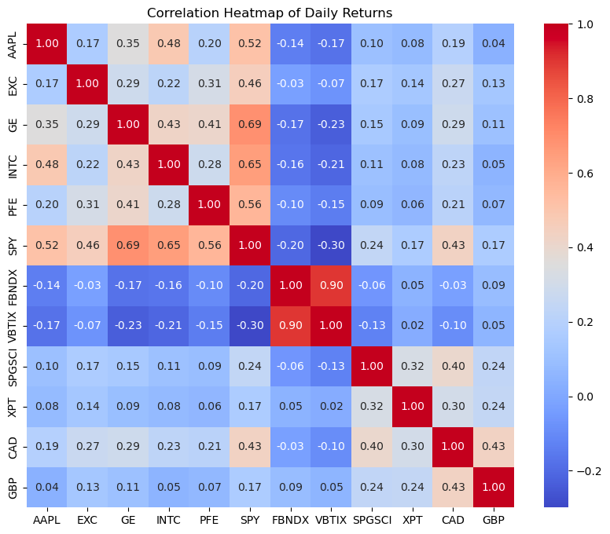
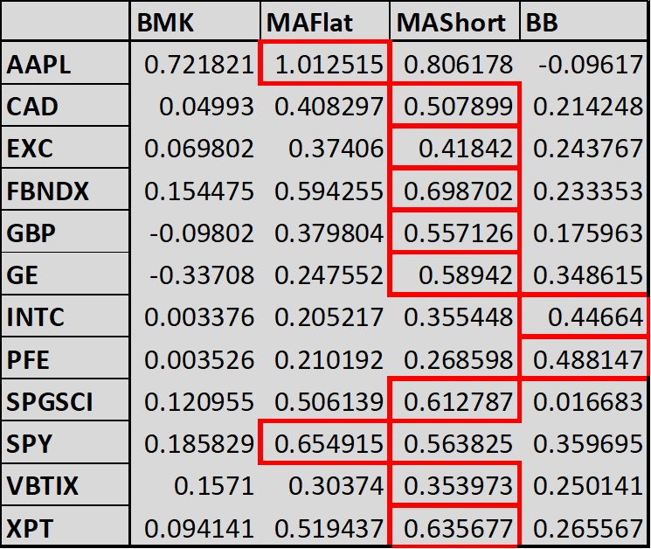
Rationale
Based on my analysis, I have chosen AAPL, SPY, GE, PFE, and INTC for my portfolio.
As INTC had a higher Sharpe ratio than EXC, I decided to exclude EXC even though it is an Energy company.
Furthermore, I have selected MAFlat for FBNDX, and MAShort for SPY because they gave better overall SR.
I have selected FBNDX, XPT, and GBP to maximize Sharpe ratios.
5

Slide 5
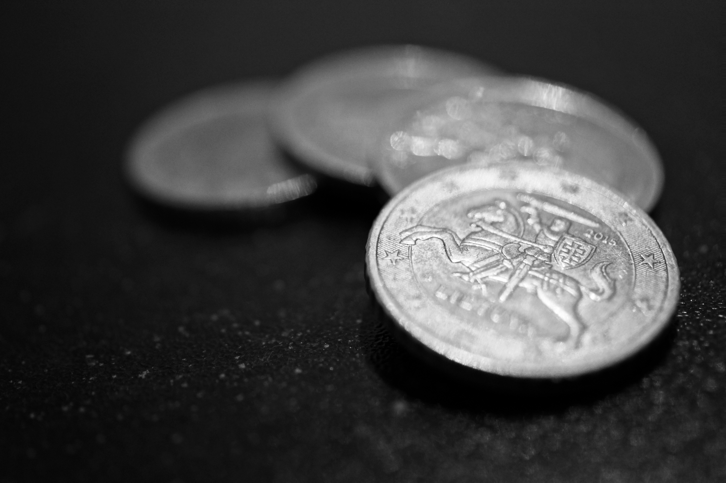
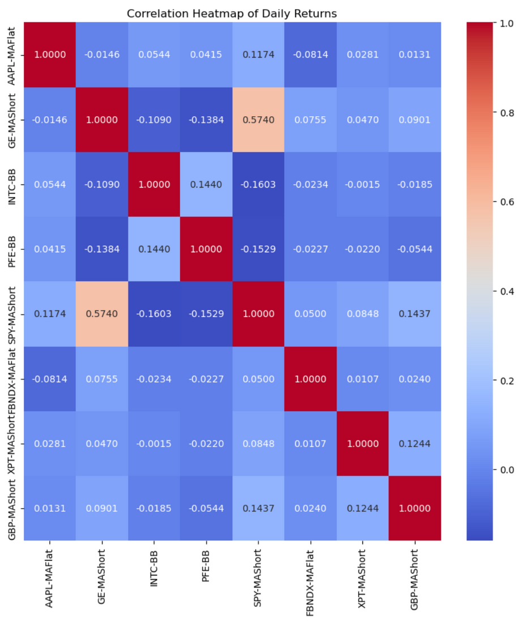
Correlation structure
Key Takeaways
Overall there are very few correlations in my portfolio, the only notable high correlation being between GE and SPY. All the other relationships were very close to 0.
Positive relationship: AAPL-MAFlat and SPY-MAShort, SPY-MAFlat and GE-MAShort, XPT-MAShort and GBP-MAShort have a positive relationship with 0.1174, 0.5740, and 0.1244 respectively.
Negative relationship: INTC-BB and SPY-MAShort, PFE-BB and SPY-MAShort, GE-MAShort and PFE-BB, INTC-BB, and GE-MAShort has a negative relationship with a correlation of -0.1603, -0.1529, -0.1384, and -0.1090 respectively.
Neutral relationship: There's no correlation = 0.
6

Slide 6
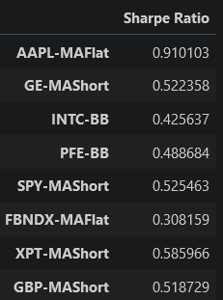
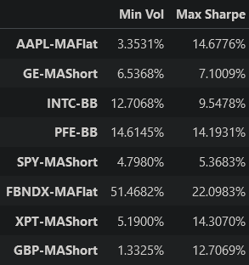
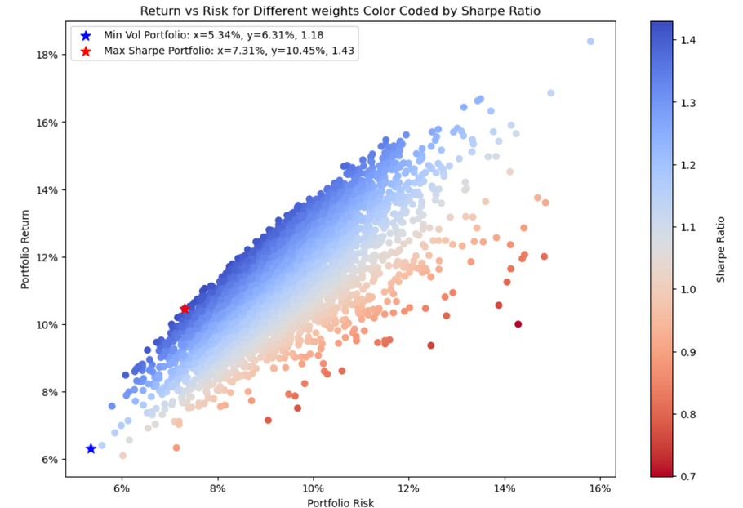
Instrument weighting scheme
Equal-weight portfolio
Weights of the Minimum-vol and the Maximum-Sharpe portfolios
The sharpe ratio of equal-weight portfolio is 1.3580500907597814. On the other hand, the sharpe ratio of max-sharpe's weight portfolio is 1.4301871754039084. Therefore, the sharpe ratio of maximum-sharpe portfolio is higher than the sharpe ratio of equal-weight portfolio.
Outperforms every individual strategy (AAPL-MAFlat, INTC-MAShort, GE-MAShort, PFE-BB, SPY-MAFlat, FBNDX-MAShort, XPT-MAShort, GBP-MAShort).
7

Slide 7
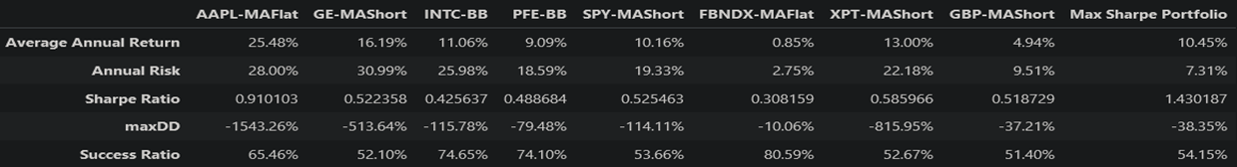
summary statistics of portfolio And Beta
Average annual return (10.45):
The return of the Max Sharpe portfolio is higher than some individual components (PFE, SPY, FBNDX, XPT, GBP) while lower than others (AAPL, GE, INTC). This suggests a balanced approach, combining high and moderate return assets.
Annual Risk (7.31%):
The portfolio has significantly lower risk compared to most individual stocks, with only the FBNDX (a bond fund) having a lower risk profile. This lower risk is indicative of effective diversification and risk management within our portfolio.
8

Slide 8

summary statistics of portfolio And Beta cont..
Success Ratio (54.15%):
The portfolio's success ratio is around the mid-range when compared to individual components. This suggests a balanced approach to capturing upside while mitigating downside risks.
Sharpe Ratio (1.430187):
The Sharpe Ratio of the portfolio is substantially higher than any individual component, indicating a superior risk-adjusted return.
Maximum Drawdown (maxDD -38.35%):
The portfolio's maxDD is lower than most of the equity components, suggesting better downside risk management.
9

Slide 9
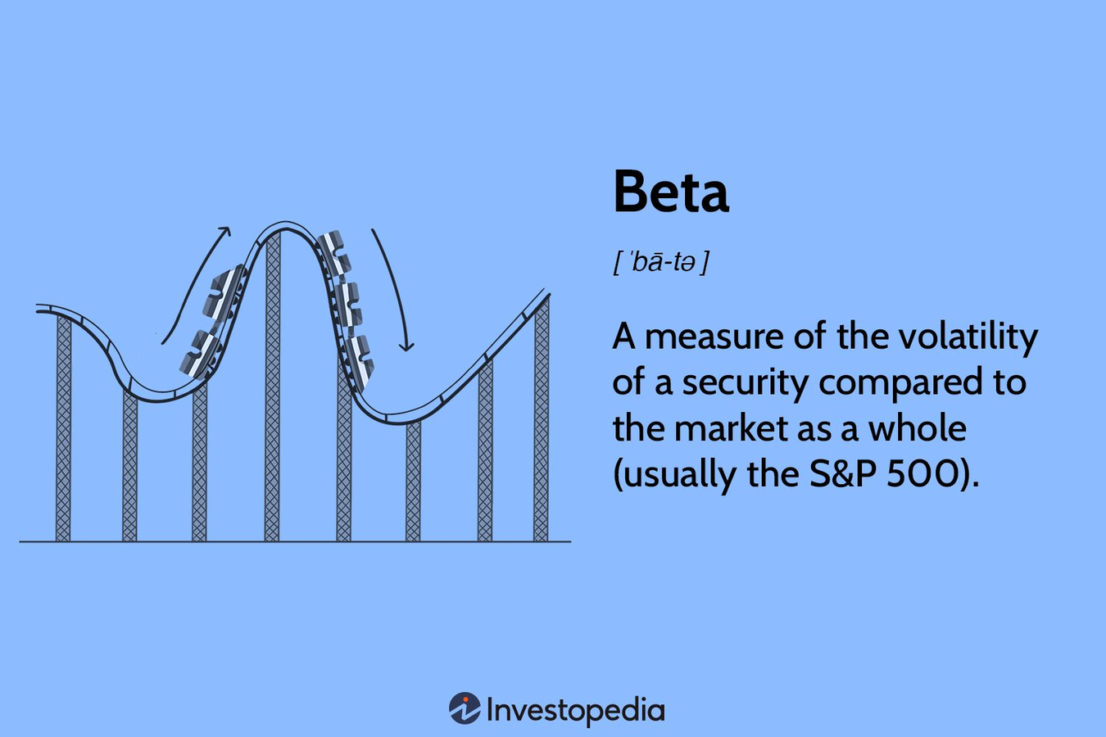
A beta Value of 0.057
Key Takeaways
This low beta suggests that the portfolio's returns are expected to be much less sensitive to market movements. In essence, it implies that the portfolio is much more stable and less affected by market swings, which is consistent with a conservative investment strategy prioritizing risk minimization.
10

Slide 10

variations of the equal-weighted portfolio
Sharp Ratio
Our Portfolio securities
Equities - AAPL, INTC, GE, PFE, SPY
Fixed income instrument - FBNDX
Commodity instrument - XPT
Currency - GBP
Bench Mark Strategy
MA-Short Strategy
Parameters for our Portfolio
Sliding Windows for the equities
Slow Window = 235, Fast Window = 22
Sliding Windows for rest of the instruments
Slow Window = 105, Fast Window = 87
Lookback Window and Stddev for the Bollinger Band Strategy
Lookback Window = 22,
Standard Deviation Band = 2
0.19917
0.64590
Maximum
1.430187
0.70512
0.06036
MA- Flat Strategy
Bollingers Bond
11

Slide 11

thank you
any Questions?

